Slide 1
Getting Big Benefits from Big Data
Jeanne G. Harris
Jeanne.g.harris@accenture.com

Slide 2
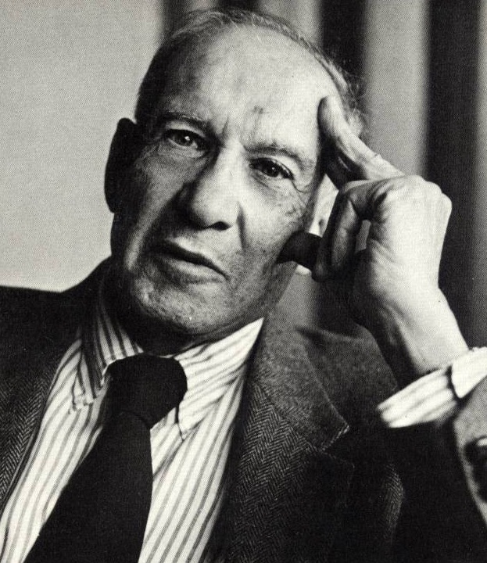
Peter Drucker: The Father of Modern Management
Four things I learned from Peter Drucker
We must seek out patterns among seemingly unconnected data and disciplines to gain valuable insights.
Businesses are complex systems, optimizing a single element is rarely creates lasting value.
It took 50 years for organizations
to fully leverage transactions systems, so it will time to realize significant value from knowledge, information and data.
What gets measured, gets done.

Slide 3
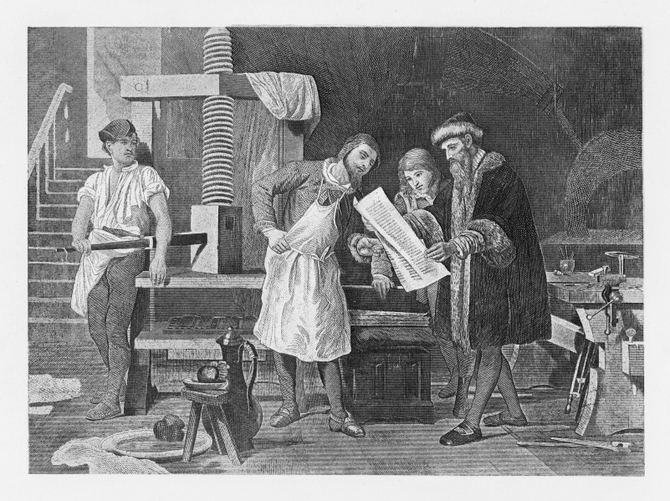
Game Changing Technological Innovations Create Darwinian Challenges.
Technological advances are radically transforming the way we create, locate, access, analyze and present information
But will they transform how businesses use data?

Slide 4

Big Data Analytics is a Game Changer
This is your moment…
Are you ready?

Slide 5


Recognize the patterns. . .
or it’s going to be déjà vu all over again.

Slide 6

Realizing Value is Critical, but Remains Elusive to Many
Business executives may
have big data déjà vu too.
It’s 1998: Data Deluge is a reality.
We’ve just begun to tap the potential of transaction and web data to gain insight or make decisions.
Enterprise transaction systems add value, but are slower to yield valuable managerial information.
Few companies routinely and consistently leverage high
volume external data to realize major business outcomes.

Slide 7
Executives understand that having lots of data, technology and data scientists is just the starting point.
“Having analytical capabilities and the best data in the world doesn’t create competitive advantage. Changing the way the business uses it is the only way to create advantage.”
– Steven Udvarhelyi, MD, Senior Vice President and Chief Medical Officer, Independence Blue Cross
“I'm not interested in data; I'm interested in translating data into information for decision making. . . . So you take data, you turn it into information, you apply it, and you make better decisions because you know more than anybody else. I think that's real power —and that was our hidden advantage for years.”
– Leonard Schaeffer, Retired CEO, Wellpoint

Slide 8
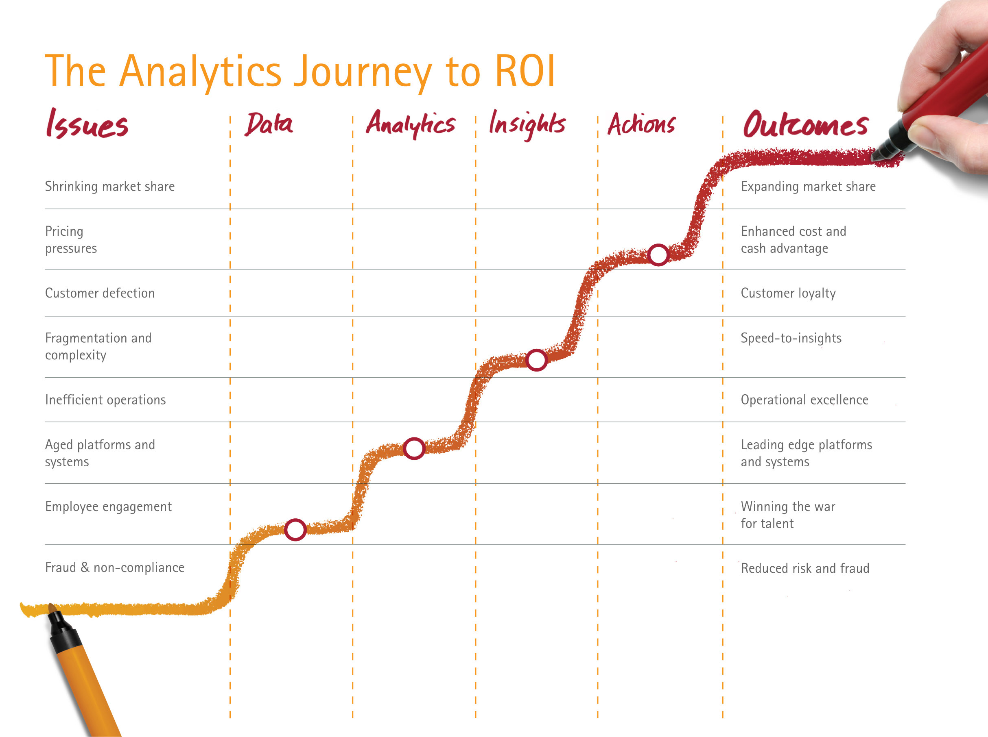
Bridging the Gap in The Analytics Journey to ROI

Slide 9

Lack of trust is the #1 barrier to the widespread adoption and impact of big data
“Data scientists, you think you’re hot stuff. But as an executive accountable for business results, guess what? You don’t understand me or my business. You don’t speak my language So I just don’t trust you or your fancy systems.”
We must forge trusting, collaborative and effective working relationships with decision makers.
Data scientists need business acumen, industry knowledge, communications, and coaching skills.

Slide 10
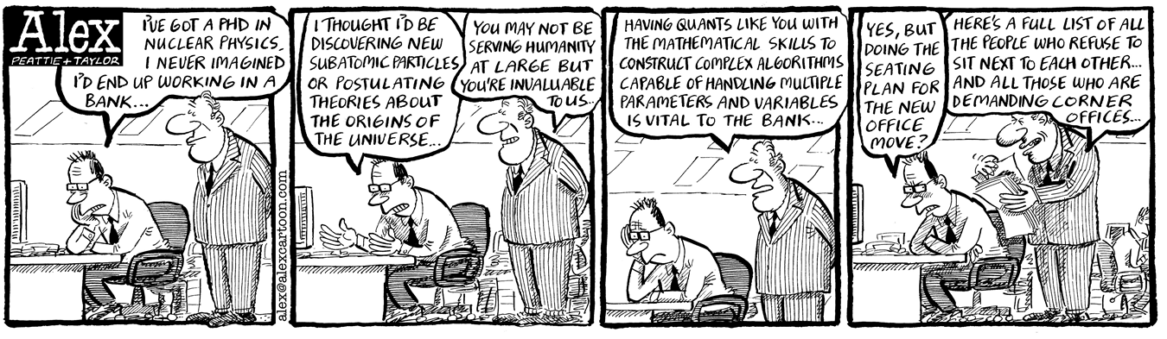
Channel your passion for big data into topics that have a major impact on business performance
Are you providing insights into the top 10 decisions in your organization?
Are you creating innovative data-enabled products and services?

Slide 11
Behaviors of Great Data-Driven, Analytical Leaders
Passionate advocate of data-driven decisions
  Set a hands-on example
  Insist on objective evidence before making decisions
  Apply rigorous logic without bias
  Challenge outdated assumptions
  Use data for innovation
Hire (very) smart people
Sign up for results
Appreciate the value (and the limitations) of big data analytics.
"In God we trust. All others must bring data.”
– W. Edwards Deming
“Do we think or do we know?”
“Vision and analytics are not mutually exclusive paradigms.”
Gary Loveman
Chairman of the Board,
President and CEO
Caesar's Entertainment

Slide 12

Many managers remain unconvinced that data is key to gaining insights, making decisions and improving performance
40% of major business decisions are not based not on data, but on “gut instinct”
– Accenture research
Extensive evidence that having experts is good, but experts using analytics is much better.
Statistical predictions consistently outperform “gut based” predictions.
Expert intuition is best only when there is little time, limited data and few variables.
Notes:
Copyright © 2007, SAS Institute Inc. All rights reserved.
12

Slide 13

Emerging managerial literacies
Data
Astute at finding, manipulating, managing, and interpreting all kinds of data
Experimental
Willing and able to apply the principles of scientific experimentation to business.
Numerate
Adept at the interpretation and use of numeric data
Appreciation for quantitative methods

Slide 14
We must prepare our workforce for a data-driven future
  “Data modeling, simulation, and other digital tools are reshaping how we innovate."
Bob McDonald, CEO, Procter & Gamble
  My organization lacks the skills needed to leverage big data.
  60% Avanade Survey, 2012
Capability Development:
Hire a different kind of managerial cadre
Changes to job design, career planning and development
Provide training to build skills and understanding
Bring smart tools out of the ivory tower
Embed data driven analysis into business processes and applications

Slide 15
Educate information workers to avoid common errors and make better data-driven decisions.
Logic Errors
Process Errors
Not recognizing when a decision is needed
Asking the wrong question or improper framing
Bad assumptions and failing to test them
Over-simplification
Withholding data/insights
Gaming they data
Failing to consider alternatives or interpret the data correctly
Inaccurate analysis
Careless mistakes
Bias for gut based decisions
Bottlenecks/organization/ network dysfunction
Incorrect or insufficient decision-making criteria
Inadequate criteria
(legal, ethical, strategic, financial, etc.)
Too late to matter
Analysis paralysis

Slide 16
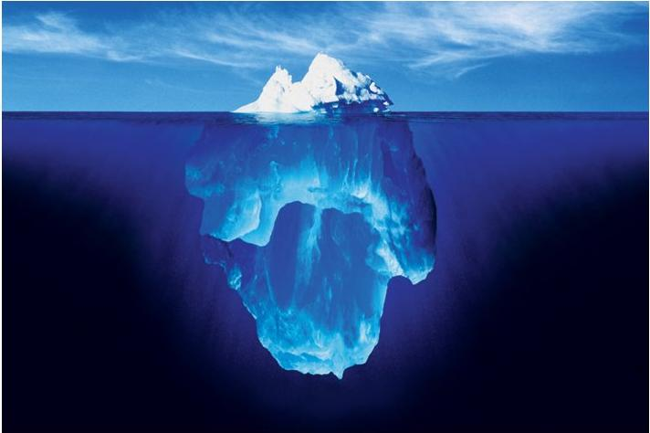
Data is a strategic asset, so start treating it like one.
How must the traditional IT perspective evolve for big data?
Business decisions
Analytics
Data access
Data integration
Data quality
Data governance
Data semantics
Data security
Master data management

Slide 17



Data is a strategic asset, so organizations need to start treating it like one.
If you don’t have or can’t find the data you need, consider creating it.
Wine chemistry
Smile Frequency
Driving behavior

Slide 18










Consider how you can monetize your data
$600B – U.S. demand for Information Services by 2015
Transact
Recommendations
Increasing Value of Data
Insights
Normalized
Raw Data
Source(s): Outsell, Zenith Optimedia, Accenture analysis

Slide 19
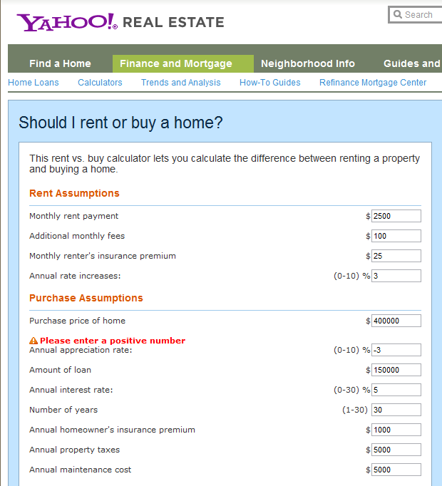
Embed data and insights into processes to make better decisions

Slide 20
Big Data Analytics is a Game Changer
This is your moment…
Will your organization be ready?

Slide 21
To join our research:
      Take our 15 min Data Scientist survey at http://www7.intellisurvey.com/run/rn01166572?pan=104
      2. Share your data monetization stories with me at jeanne.g.harris@accenture.com

